Slide 1
Road Accident Prediction
Team Members: (Team-10)
Sai Rohith Guntupally (8)
Chaitanya Mallepudi (14 )
Madhu Varma Rudraraju (20)

Slide 2
Objective
Main objective of this model is to predict the probability of road accidents based on the existing accident record (US accident) dataset.
There is no high accuracy model that predicts the accident based on the given inputs. This motivated us to build the high accuracy classification model.

Slide 3
Data Description
The purpose of building this model is to create a classifier capable of predicting the accidents. It comprises of:
Weather and Temperatures during accident.
Road conditions.
Severity of accident.
Location of accident.

Slide 4
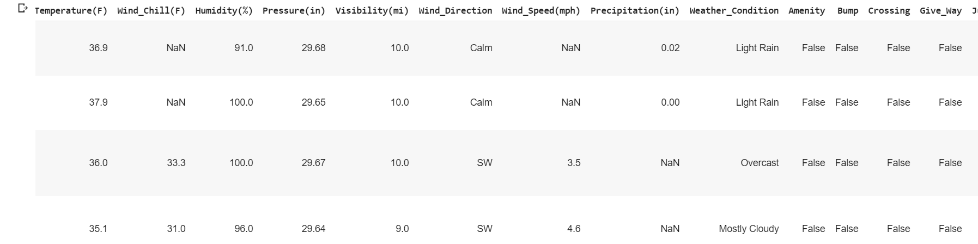
Data Sample
Features in dataset:

Slide 5
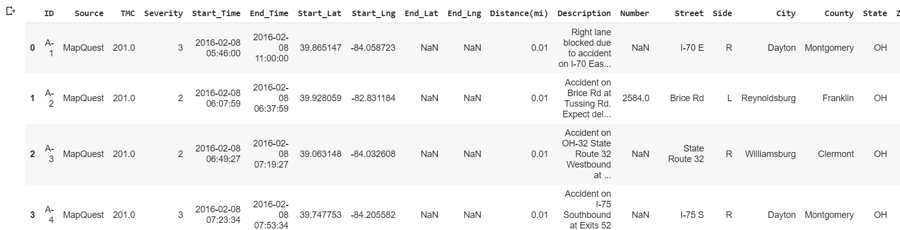

Slide 6
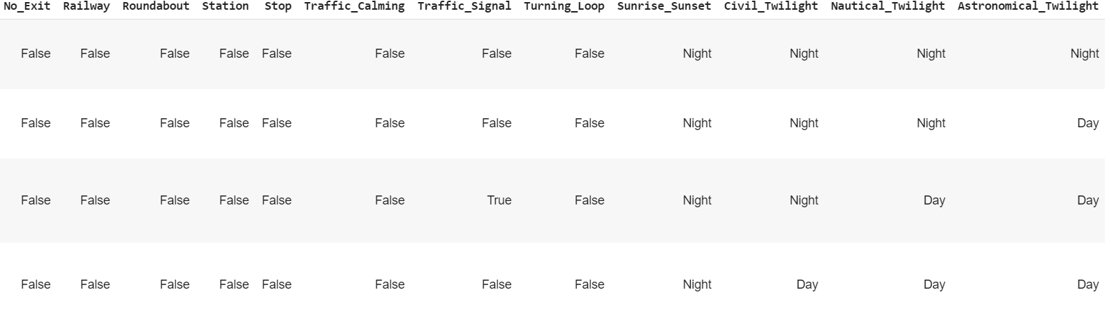

Slide 7
Approach
We are adding a column named accident probability based on severity of accident.
When the severity is very low, probability is 0; else it is 1.
We pre-processed the dataset and removed the unnecessary features..
We calculated the accuracy of the model using Naïve-Bayes classification.
We implemented Deep Learning techniques, and to get accurate results out of it we have chosen this approach.

Slide 8
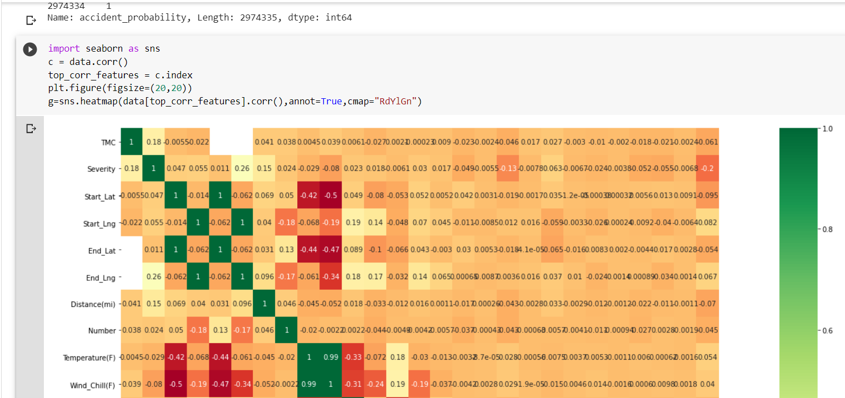
.

Slide 9
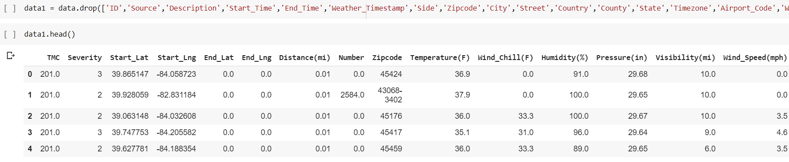
Preprocessing Steps
With the help of correlation matrix, we had removed the less correlated features.

Slide 10
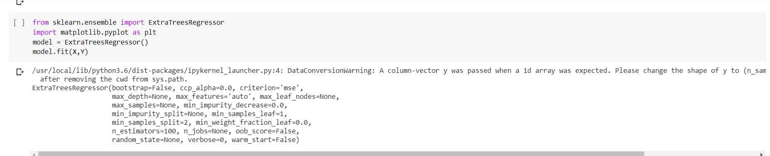
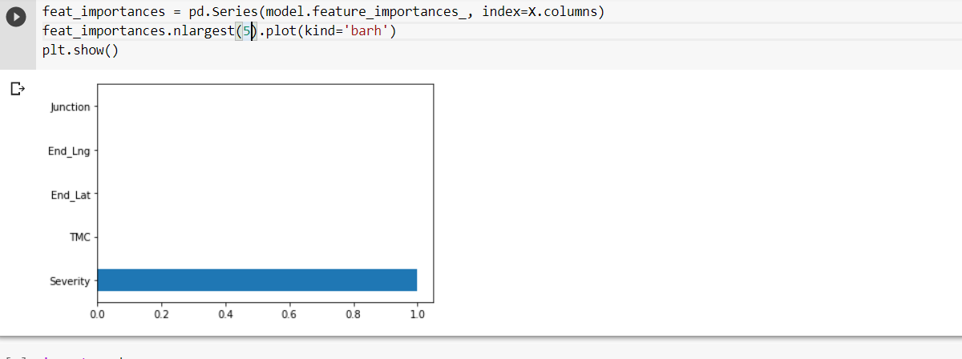
Extra Tree Regressor

Slide 11
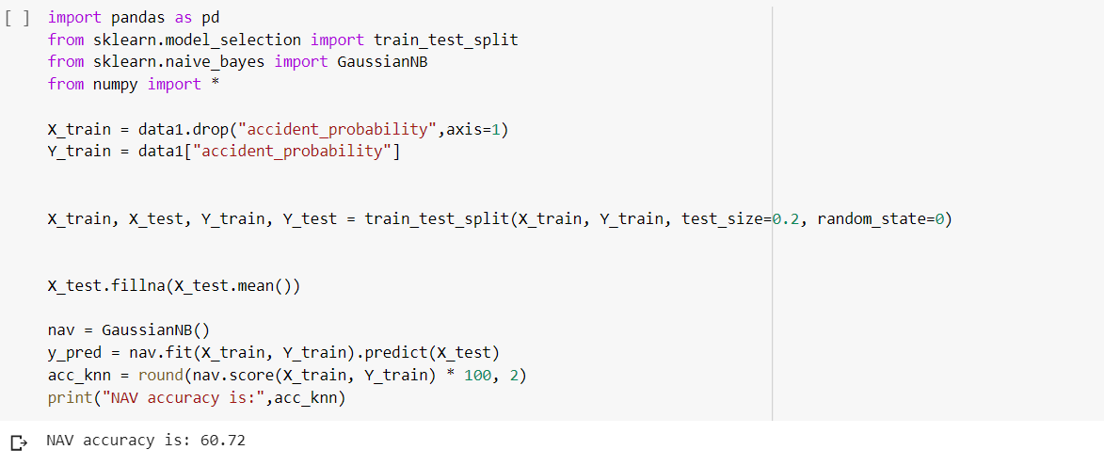
Naive’s Baye’s Classification:

Slide 12
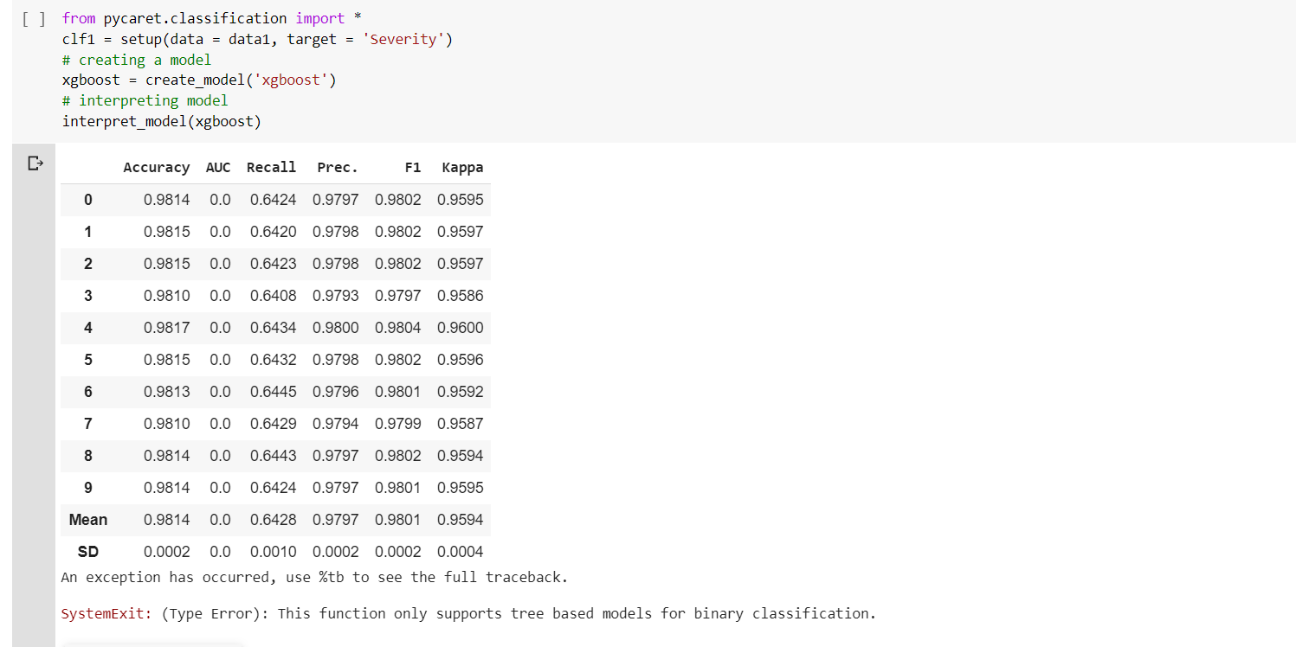
PyCaret
We have implemented a automated model Pycaret which boosts our model

Slide 13
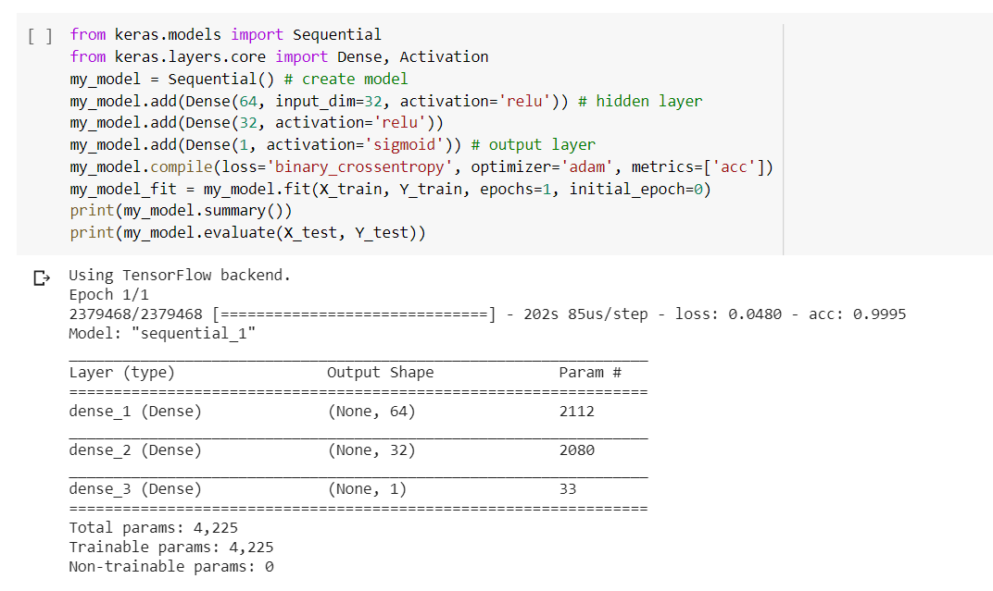
Model Creation
We have used sequential model.
We have built three hidden layers which results in high accuracy to build an efficient model.
We have saved the hd5 model and with the model of accuracy of 99%

Slide 14
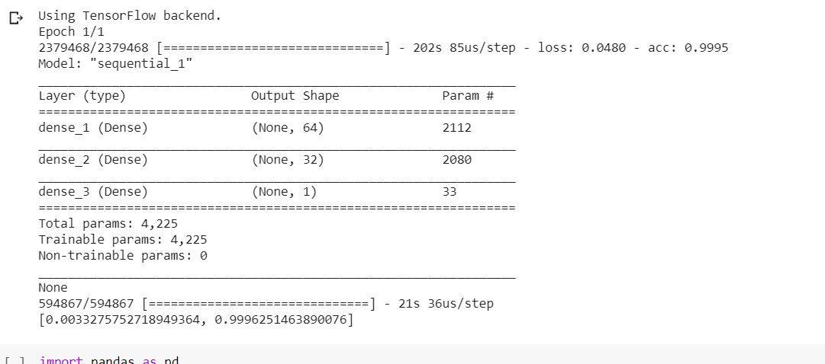
Model Evaluation:

Slide 15
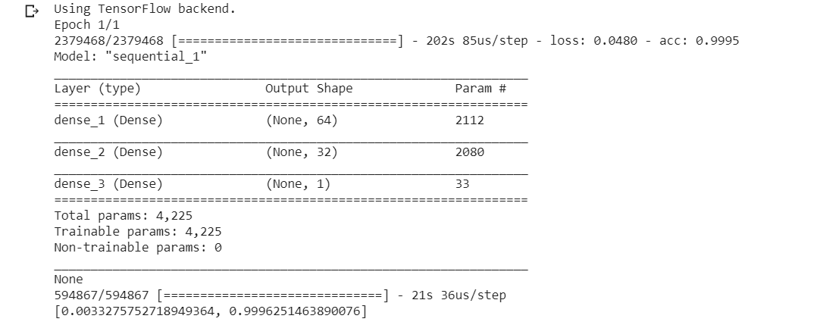
Model Accuracy
Accuracy is 99%.

Slide 16
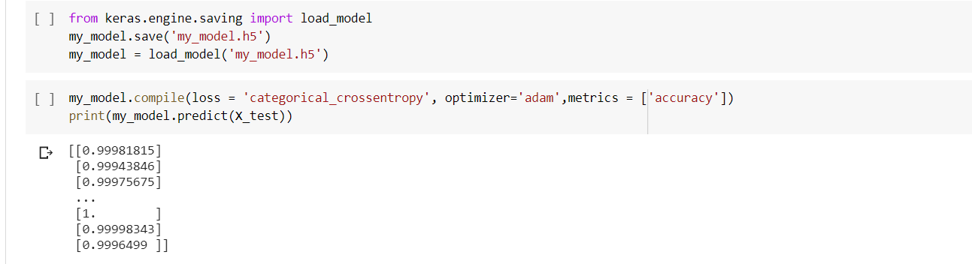
Test the Model
We can test our h5 model by passing the test data.

Slide 17
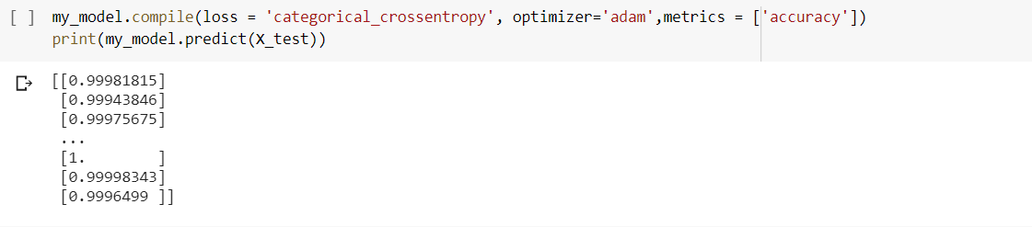
Test Results

Slide 18
Challenges:
To build this model, we faced major challenge to pre process the data, find out the correlated features, keep only necessary features and fit the model.

Slide 19
Conclusion
Using a subset of the samples provided in the dataset of each sample for training, we can achieve an accuracy.
Using the test data, we can predict the probability of an accident with high accuracy.

Slide 20





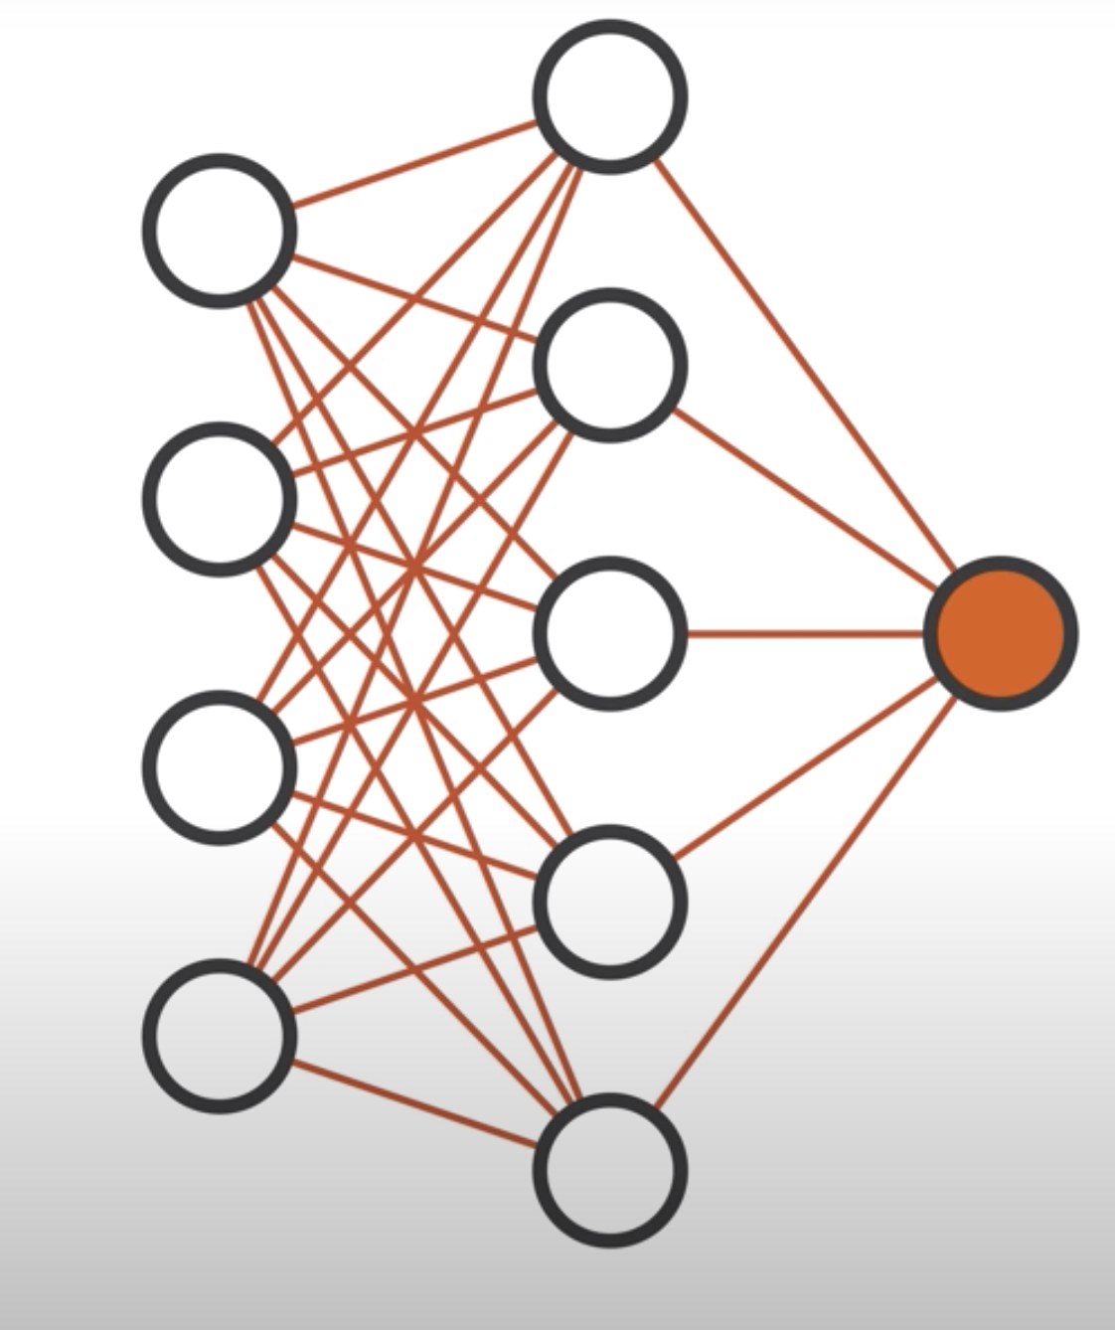
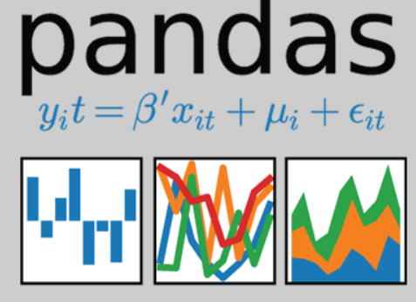

Technologies and Softwares:
Pycharm
Python 3.7
Google Colab
matplotlib
Pandas
Keras

Slide 21
Project Links
Github Link:
https://github.com/MRChaitanya/PythonDeepLearning/tree/master/project
Increment -1
https://github.com/MRChaitanya/Python-DeepLearning/wiki/Project-Increment--1
Increment -2
https://github.com/MRChaitanya/Python-DeepLearning/wiki/Project-Increment--2

Slide 22
References
https://www.kaggle.com/us-accidents
https://pycaret.org/
https://stackoverflow.com/
https://www.tensorflow.org/api_docs/python/tf/keras/Model

